Slide 1


John Deere SVO
Engines and Energy Conversion Laboratory
Jordan Purvis
Ryan Saunders
Sam Slaten
Nicholas Ryan Walker
Daniel Yacobucci
Advisor: Dr. Dan Olsen
John Deere: Curtis Stovall

Slide 2
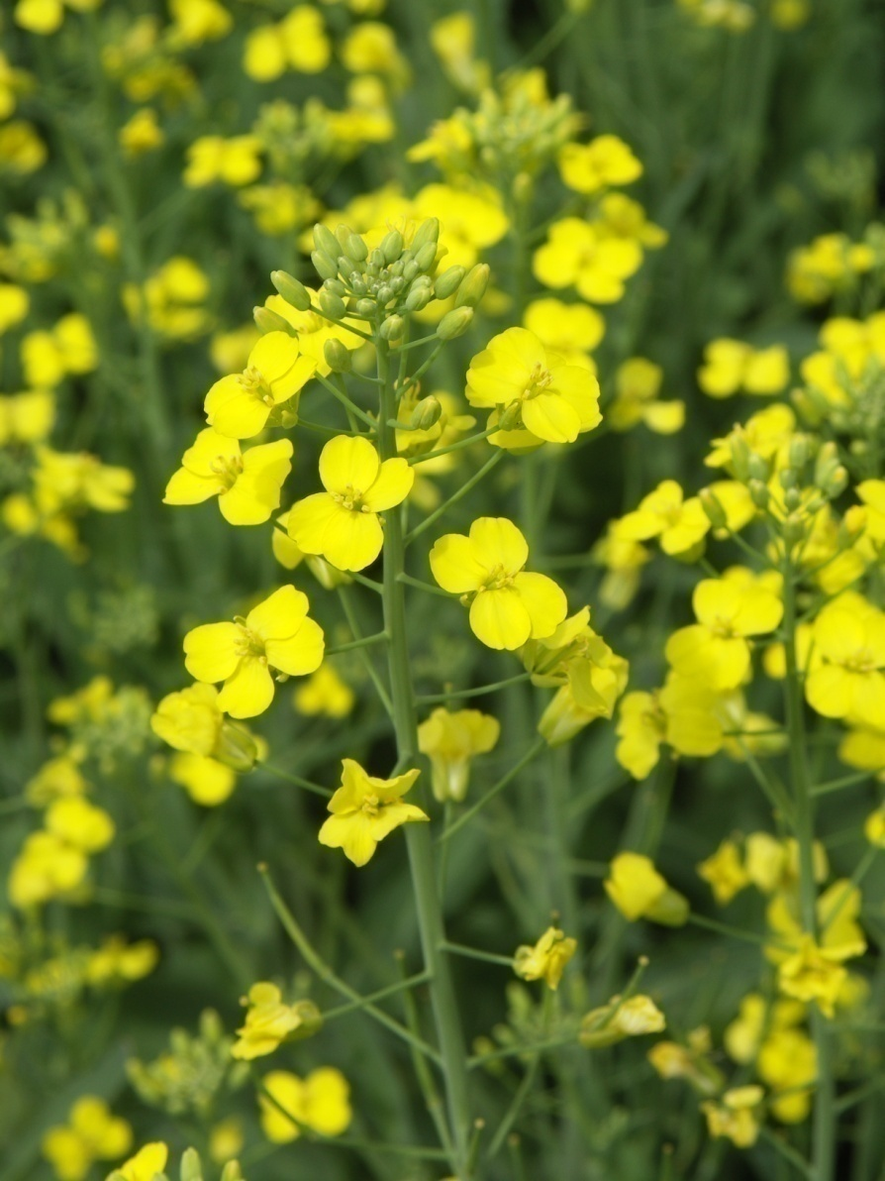
Outline:
Introduction
  Problem Statement
  Project Tasks
  Constraints and Criteria
  Why SVO?
Fuels
  Characteristics
  Fuel System Layout
Baseline Testing
  Performance
  Emissions
  Fuel Consumption
Fuel Switching Transients
Fuel Temperature Effects
  Consumption
  Peak Pressure
Timing Sweeps
Final Data Review
  Consumption
  Emissions
  FTIR
  Fuel System Layout
Summary

Slide 3
Outline:
Introduction
  Problem Statement
  Project Tasks
  Constraints and Criteria
  Why SVO?
Fuels
  Characteristics
  Variances
  Fuel System Layout
Baseline Testing
  Performance
  Emissions
  Fuel Consumption
Fuel Switching Transients
Fuel Temperature Effects
  Consumption
  Peak Pressure
Timing Sweeps
Final Data Review
  Consumption
  Emissions
  FTIR
  Fuel System Layout
Summary

Slide 4
Problem Statement:
“Evaluate the performance and emissions characteristics of a John Deere, common rail, CI engine while operating on straight vegetable oil.”
Project Tasks:
Fuel System Redesign.
8-Mode Emissions & Baseline Performance.
Injection Timing Probe.
Timing Sweeps.
Final 8-Mode Emissions & Performance Testing.

Slide 5
Constraints:
Testing conforms to ISO 8178 8-Mode standards.
Engine must switch between diesel and SVO operations while preventing cross-contamination.
Analysis must be completed before E-days and Waterloo trip.
Do not destroy the engine.
Criteria: Prioritized by weight from 5 (highest) to 1 (lowest).
5. Find max torque of engine while running SVO.
4. Investigate fuel rail pressure effects on engine performance.
3. Investigate timing effects on engine performance.
2. Evaluate possible modifications to combined (diesel & SVO) fuel system.
1. Investigate potential fuel blends/additives for performance enhancement.

Slide 6

Why SVO?
Renewable fuel source.
Users of John Deere equipment are able to produce own SVO to offset diesel fuel consumption.
Minimal processing.
Minimal energy input.
Some varieties can be grown in arid climate requiring minimal irrigation.
Lends itself well for combustion in compression ignition engines.

Slide 7
Outline:
Introduction
  Problem Statement
  Project Tasks
  Why SVO?
Fuels
  Characteristics
  Variances
  Fuel System Layout
Baseline Testing
  Performance
  Emissions
  Fuel Consumption
Fuel Switching Transients
Fuel Temperature Effects
  Consumption
  Peak Pressure
Timing Sweeps
Final Data Review
  Consumption
  Emissions
  FTIR
  Fuel System Layout
Summary

Slide 8
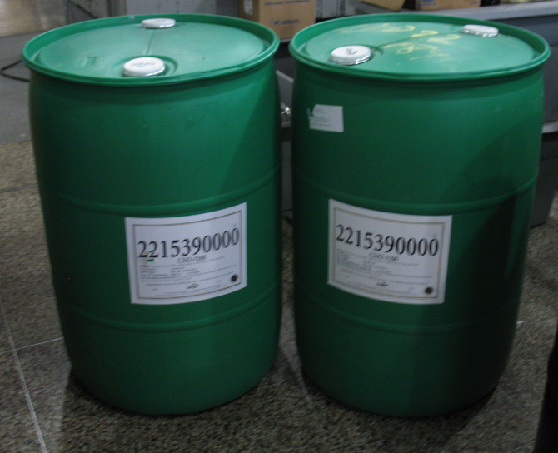

Types of fuels used:
Red-dyed #2 Diesel
Clear Valley 75 Canola Oil
- 110 gallons donated by Cargill
- 75% Oleic acid with 1500 ppm TBHQ antioxidant

Slide 9
Fuel Characteristics:
Profile for SVO: Clear Valley 75; Cargill
Carbon # : Double bonds | Carbon # : | Double bonds | % Composition | Molecular Formula | # Hydrogen | Name | Molar Mass [g/mol] | Density [g/cm³] | Melting Point [°C] | Boiling Point [°C]
C14:0 | 14 | 0 | 0.0601 | C₁₄H₂₈O₂ | 28 | Myristic acid | 228.37092 | 0.8622 | 54.4 | 250.5
C16:0 | 16 | 0 | 3.3809 | C₁₆H₃₂O₂ | 32 | Palmitic acid | 256.42 | 0.853 | 62.9 | 351.5
C16:1 | 16 | 1 | 0.2723 | C₁₆H₃₀O₂ | 30 | Palmitoleic acid | 254.408 | 0.894 | -0.1
C18:0 | 18 | 0 | 2.0349 | C₁₈H₃₆O₂ | 36 | Stearic acid | 284.48 | 0.847 | 69.6 | 383
C18:1 | 18 | 1 | 77.6842 | C₁₈H₃₄O₂ | 34 | Oleic acid | 282.4614 | 0.895 | 13.5 | 360
C18:2 | 18 | 2 | 9.5647 | C₁₈H₃₂O₂ | 32 | Linoleic acid | 280.45 | 0.9 | -5 | 229
C18:3 | 18 | 3 | 3.0469 | C₁₈H₃₀O₂ | 30 | α-Linolenic | 278.43 |  | -11 | 230
C20:0 | 20 | 0 | 1.2019 | C₂₀H₄₀O₂ | 40 | Arachidic acid | 312.5304 | 0.824 | 75.5 | 328
C20:1 | 20 | 1 | 1.3925 | C₂₀H₃₈O₂ | 38 | Eicosenoic acid | 31.51 | 0.883 | 23.5
C20:2 | 20 | 2 | 0.5494 | C₂₀H₃₆O₂ | 36 | Eicosadienoic acid | 308.5
C22:0 | 22 | 0 | 0.4086 | C₂₂H₄₄O₂ | 44 | Behenic acid | 340.54 |  | 80 | 306
C22:1 | 22 | 1 | 0.0325 | C₂₂H₄₂O₂ | 42 | Erucic acid | 338.57 | 0.86 | 33.8 | 381.5
C24:0 | 24 | 0 | 0.2333 | C₂₄H₄₈O₂ | 48 | Lignoceric acid | 368.63 |  | 84.2
C24:1 | 24 | 1 | 0.1379 | C₂₄H₄₆O₂ | 46 | Nervonic acid | 366.32 |  | 42.5
Total Sats: |  |  | 7.3197
Sum: |  |  | 100.0001
*Cargill Confidential Information

Slide 10
Fuel Characteristics:

Slide 11
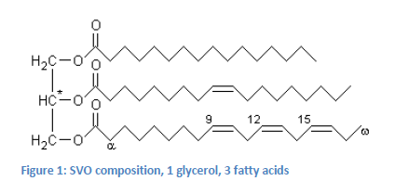
Fuel Characteristics:
Fuel | Diesel | SVO (Canola)
Density [kg/l] | 0.86 | 0.92
LHV [kJ/kg] | 42500 | 37000
Formula | C_{12.3}H_{22.2} | C_{57.08}H_{109.63}O₂

Slide 12
SVO vs. Diesel Variance 1: Viscosity:

Slide 13
SVO vs. Diesel Variance 2: Heating Value:

Slide 14
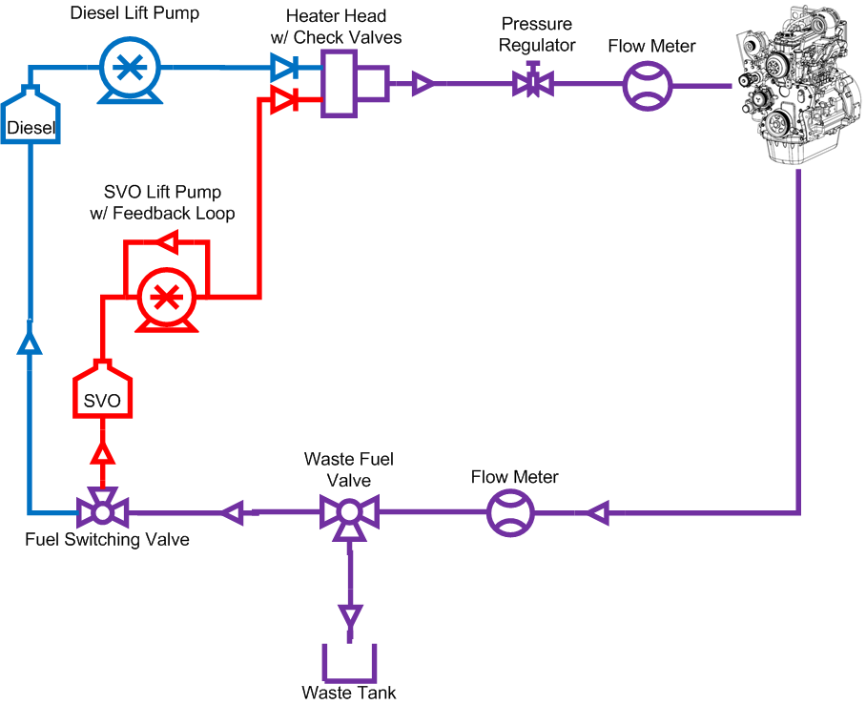
Research Fuel System Layout:

Slide 15
Outline:
Introduction
  Problem Statement
  Project Tasks
  Constraints and criteria
  Why SVO?
Fuels
  Characteristics
  Variances
  Fuel System Layout
Baseline Testing
  Performance
  Emissions
  Fuel Consumption
Fuel Switching Transients
Fuel Temperature Effects
  Consumption
  Peak Pressure
Timing Sweeps
Final Data Review
  Consumption
  Emissions
  FTIR
  Fuel System Layout
Summary

Slide 16
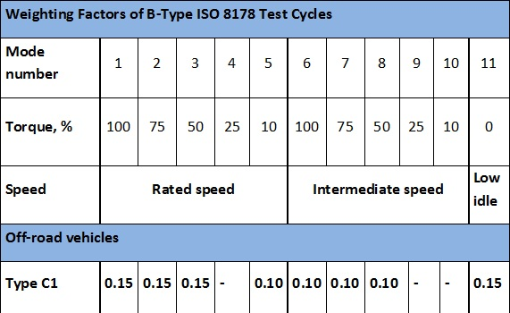
Baseline Testing:

Slide 17
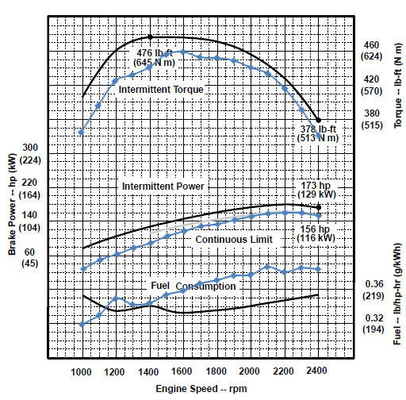
Performance:
Diesel Performance Curves
4% difference
15% Air Density Difference
3% difference
11% difference

Slide 18
Performance:

Slide 19
Performance:

Slide 20
Pollutant Emissions:

Slide 21
Particulate Emissions:

Slide 22
Fuel Consumption:

Slide 23
Outline:
Introduction
  Problem Statement
  Project Tasks
  Constraints and criteria
  Why SVO?
Fuels
  Characteristics
  Variances
  Fuel System Layout
Baseline Testing
  Performance
  Emissions
  Fuel Consumption
Fuel Switching Transients
Fuel Temperature Effects
  Consumption
  Peak Pressure
Timing Sweeps
Final Data Review
  Consumption
  Emissions
  FTIR
  Fuel System Layout
Summary

Slide 24
Transient Behavior:

Slide 25
Transient Behavior:

Slide 26
Transient Behavior:
Power and torque curves followed the expected trends in transitioning between the fuels.
The torque and power decreased when transitioning from diesel to SVO, and increased when transitioning from SVO to diesel.
This is expected because of a lower LHV for SVO.
Both transitions were recorded at 2400RPM, 50% load (Mode 3).
Fuel consumption is difficult to measure during transition because of the varying fuel density.

Slide 27
Outline:
Introduction
  Problem Statement
  Project Tasks
  Constraints and criteria
  Why SVO?
Fuels
  Characteristics
  Variances
  Fuel System Layout
Baseline Testing
  Performance
  Emissions
  Fuel Consumption
Fuel Switching Transients
Fuel Temperature Effects
  Consumption
  Peak Pressure
Timing Sweeps
Final Data Review
  Consumption
  Emissions
  FTIR
  Fuel System Layout
Summary

Slide 28
Fuel Temperature vs. Fuel Consumption:
Viscosity vs. Temperature

Slide 29
Fuel Temperature vs. Emissions:
With the higher temperature SVO there was a slight reduction in NOx and a slight increase with CO.

Slide 30
Fuel Temperature vs. Emissions:
Again we see a trend at higher temperatures of a slight reduction in NOx and a slight increase in CO. This can be better explained when looking at the peak pressure in cylinder.

Slide 31
Fuel Temperature vs. Peak Pressure:
The peak pressure was seen earlier in the combustion cycle with the increased temperature SVO.
This advance causes higher cylinder temperatures and more complete combustion which explains fluctuation in emissions.

Slide 32
Outline:
Introduction
  Problem Statement
  Project Tasks
  Constraints and criteria
  Why SVO?
Fuels
  Characteristics
  Variances
  Fuel System Layout
Baseline Testing
  Performance
  Emissions
  Fuel Consumption
Fuel Switching Transients
Fuel Temperature Effects
  Consumption
  Peak Pressure
Timing Sweeps
Final Data Review
  Consumption
  Emissions
  FTIR
  Fuel System Layout
Summary

Slide 33
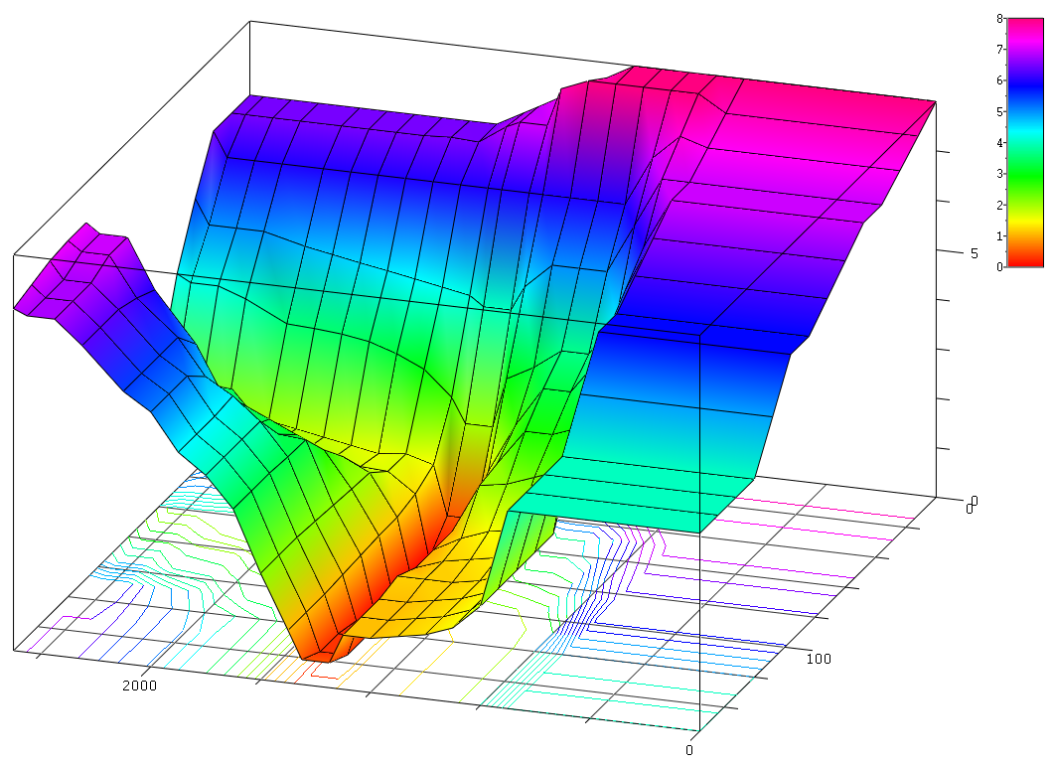
Timing Adjustment:
Timing Sweep tested from 10°bTDC to
-5°bTDC
Timing Sweep tested at 2400RPM; 10% Load, and 50% Load.
Engine Speed(RPM)
Desired Fuel(mg/stroke)
 | 0 | 700 | 800 | 900 | 1000 | 1100 | 1200 | 1300 | 1350 | 1450 | 1500 | 1600 | 1700 | 1800 | 1900 | 2000 | 2100 | 2250 | 2350 | 2450 | 2500
0 | 8 | 8 | 8 | 8 | 8 | 8 | 7.7 | 7.4 | 7.25 | 6.95 | 6.8 | 6.5 | 6.5 | 6.5 | 6.5 | 6.5 | 6.5 | 6.5 | 6.5 | 6.5 | 6.5
12 | 7.66 | 7.66 | 8 | 8 | 8 | 8 | 8 | 7.77 | 7 | 7 | 6.88 | 6.5 | 6.53 | 6.5 | 6.5 | 6.5 | 6.5 | 6.5 | 6.5 | 6.5 | 6.5
24 | 7.33 | 7.33 | 7.5 | 7 | 6 | 6 | 6 | 6 | 6 | 6 | 6 | 6 | 6 | 6 | 6 | 6 | 6 | 6 | 6 | 6 | 6.5
36 | 7 | 7 | 7 | 6 | 5 | 5 | 5 | 4.5 | 4 | 4 | 4.2 | 4.3 | 4.4 | 4.5 | 4.59 | 4.7 | 4.8 | 5 | 5 | 5 | 5.5
48 | 7 | 7 | 6 | 4.5 | 3.7 | 3.7 | 3.3 | 3 | 2 | 2 | 2.5 | 3 | 3.25 | 3.43 | 3.52 | 3.56 | 3.59 | 4 | 4.2 | 4.2 | 4.34
60 | 6.59 | 6.59 | 5.5 | 4 | 3.3 | 3.3 | 2.5 | 1.5 | 0.5 | 0.5 | 1.5 | 1.66 | 1.59 | 1.7 | 1.8 | 1.9 | 2 | 2.09 | 2.2 | 2.2 | 2.7
72 | 6.2 | 6.2 | 5 | 3 | 2.8 | 2.8 | 2.09 | 1 | 0 | 0 | 1.27 | 1.66 | 1.7 | 1.8 | 1.9 | 2 | 2.09 | 2.5 | 3 | 3 | 3.4
84 | 5.8 | 5.8 | 4 | 2.5 | 2.3 | 2.09 | 2 | 1 | 0 | 0 | 1.16 | 2 | 2.27 | 2.4 | 2.52 | 2.75 | 3.36 | 3.45 | 3.8 | 3.8 | 4.3
96 | 5.8 | 5.8 | 3 | 1.8 | 1.59 | 1.5 | 1.3 | 1 | 0 | 0 | 1.16 | 2.03 | 2.76 | 3 | 3.25 | 3.5 | 3.8 | 4 | 4.8 | 4.8 | 5.2
108 | 4.9 | 4.9 | 2 | 1.59 | 1.4 | 1.3 | 1.2 | 1 | 0 | 0 | 1.13 | 2.07 | 3.33 | 3.38 | 3.46 | 4.02 | 5 | 6 | 7 | 7 | 7.2
120 | 4 | 4 | 2 | 1.5 | 1.3 | 1.2 | 1.2 | 1.2 | 0.2 | 0.2 | 1.09 | 2.11 | 3.34 | 4 | 4.45 | 4.77 | 5.5 | 6.2 | 7 | 7 | 7.2
132 | 4 | 4 | 2 | 1.5 | 1.3 | 1.2 | 1.09 | 1.09 | 0.3 | 0.3 | 1.06 | 2.15 | 3.38 | 4 | 4.4 | 5.15 | 5.5 | 6.33 | 6.8 | 6.8 | 7.15
144 | 4 | 4 | 2 | 1.5 | 1.3 | 1.2 | 1.09 | 1.09 | 0.3 | 0.3 | 1.06 | 2.15 | 3.38 | 4 | 4.4 | 5.15 | 5.5 | 6.33 | 6.8 | 6.8 | 7.03
156 | 4 | 4 | 2 | 1.5 | 1.3 | 1.2 | 1.09 | 1.09 | 0.5 | 0.5 | 1.06 | 2.15 | 3.38 | 4 | 4.4 | 5.15 | 5.5 | 6.33 | 6.8 | 6.8 | 6.91

Slide 34
Emissions Comparisons, Stock Calibration:

Slide 35
Emissions Comparisons, Stock Calibration:

Slide 36
Timing vs. Emissions:

Slide 37
Timing vs. Emissions:

Slide 38
Timing vs. Fuel Consumption:

Slide 39
Timing vs. Fuel Consumption:
As shown in plots above a timing shift of 3 degrees advance shows the best balance of fuel consumptions and emissions improvements.

Slide 40
Outline:
Introduction
  Problem Statement
  Project Tasks
  Constraints and criteria
  Why SVO?
Fuels
  Characteristics
  Variances
  Fuel System Layout
Baseline Testing
  Performance
  Emissions
  Fuel Consumption
Fuel Switching Transients
Fuel Temperature Effects
  Consumption
  Peak Pressure
Timing Sweeps
Final Data Review
  Consumption
  Emissions
  FTIR
  Fuel System Layout
Summary

Slide 41
Final Fuel Consumption:
Timing changes contribute to a significant reduction in fuel consumption:
  7% decrease for Mode 3 (2400rpm, 50% Torque).
  8% decrease for Mode 5 (2400rpm, 10% Torque).

Slide 42
Final Emissions Data:
Timing changes contribute to a significant reduction in regulated emissions:
  24% reduction in CO emissions.
  11% reduction in NOx emissions.
  18% reduction in THC emissions.
  9% reduction in PM emissions.
SVO as fuel

Slide 43
Final Emissions Data:
Timing changes contribute to a significant reduction in regulated emissions:
  7% reduction in PM emissions.
  (reduced from 0.06775 to 0.06286 g/bkWhr)

Slide 44
Final Emissions Data:

Slide 45
FTIR Data:
Mode 2:
2400rpm, 75% Torque
Mode 5:
2400rpm, 10% Torque
Mode 6:
1700rpm, 100% Torque
Above are the emissions (in ppm) of aldehydes across various modes.
Currently the EPA does not regulate these emissions for diesel engines (only natural gas engines)
yet the trend in Europe may speak of things to come.

Slide 46
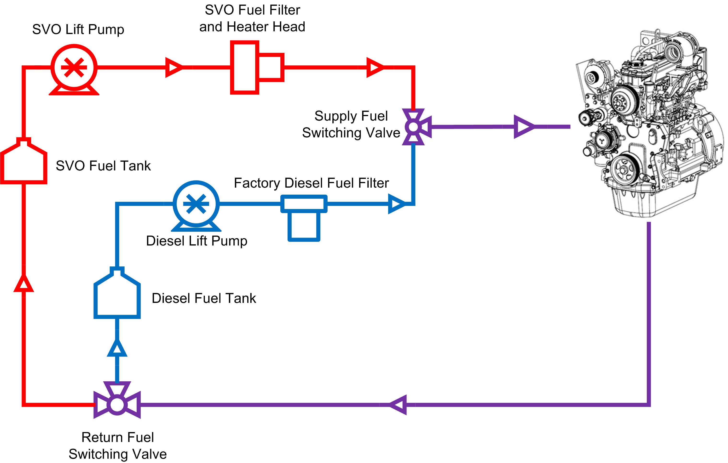
Practical Fuel System Layout:

Slide 47
Summary:
Engine Performance:
Maximum engine torque and power are approximately 3-4% lower at 5000 ft above sea level when compared to John Deere provided specifications.
Under high load conditions, SVO is an advantageous alternative fuel to diesel, while at lower loads, diesel is the preferred fuel.
Injection Timing:
After timing sweeps, it was found that 3 degrees advanced injection timing improves emissions and fuel consumption on SVO.
SVO Temperature:
Preheating SVO is advantageous for system performance.
At room temperature (23°C), engine is unable to maintain load and surges or stalls at idle.
At intermediate temperature (57-60°C) engine performs normally with increased fuel consumption vs high temperature fuel.
At high temperature (75-78°C) engine performs normally with decreased fuel consumption and slight reduction in emissions vs intermediate fuel temperature.

Slide 48



Acknowledgements:
Dr. Daniel Olsen (Project Advisor)
Kirk Evans (EECL Lab Manager)
Phil Bacon (EECL Research Engineer)
Cory Kreutzer (EECL Research Engineer)
Syndi Nettles-Anderson (MECH486 TA)
Daren Coonrod (Cargill Oils)
Chase Crouch (Colorado Equipment)

Slide 49
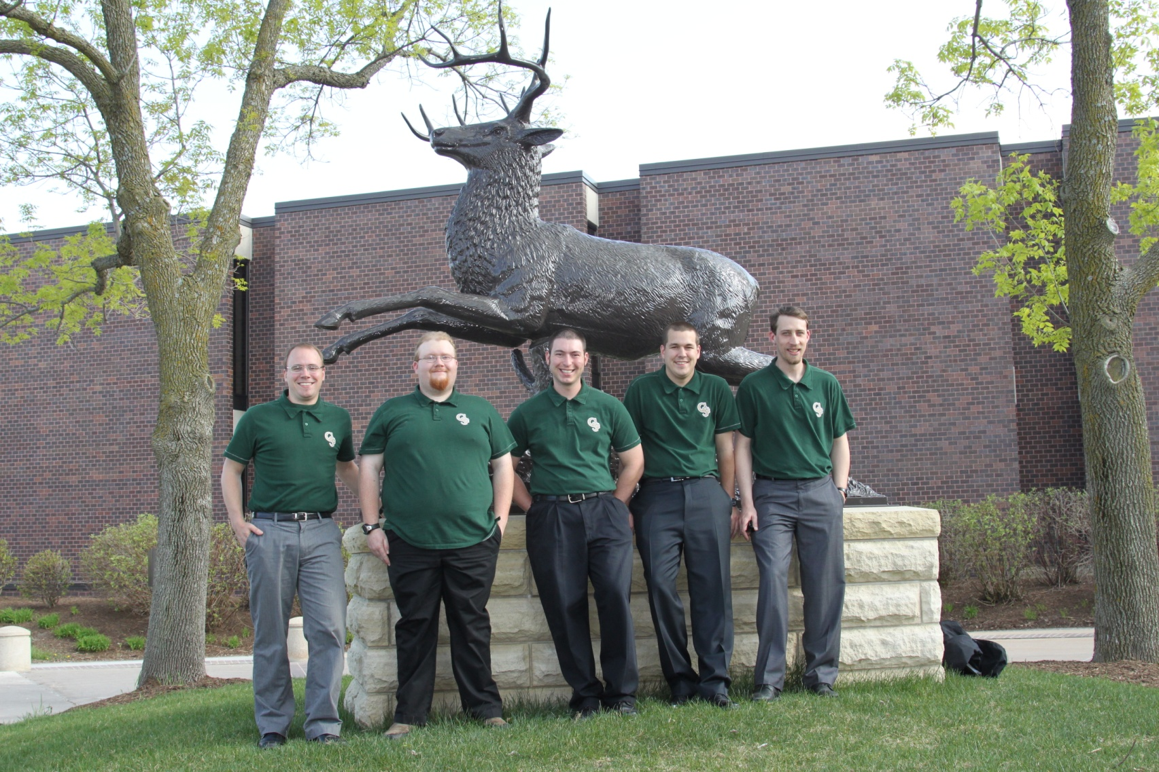
Questions?

